Slide 1
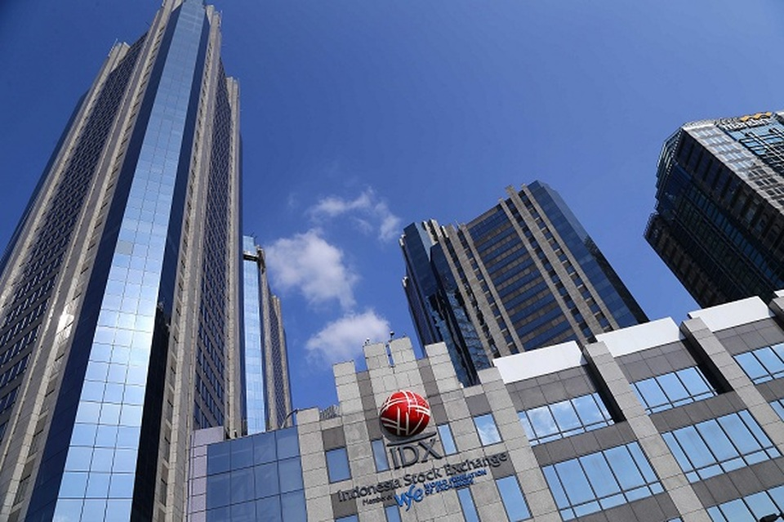
CK COACHING GROUP
CEO SUITES
Indonesia Stock Exchange
17th Floor, Jl. Jend. Sudirman Kav. 52-53
Jakarta 12190, Indonesia

Slide 2
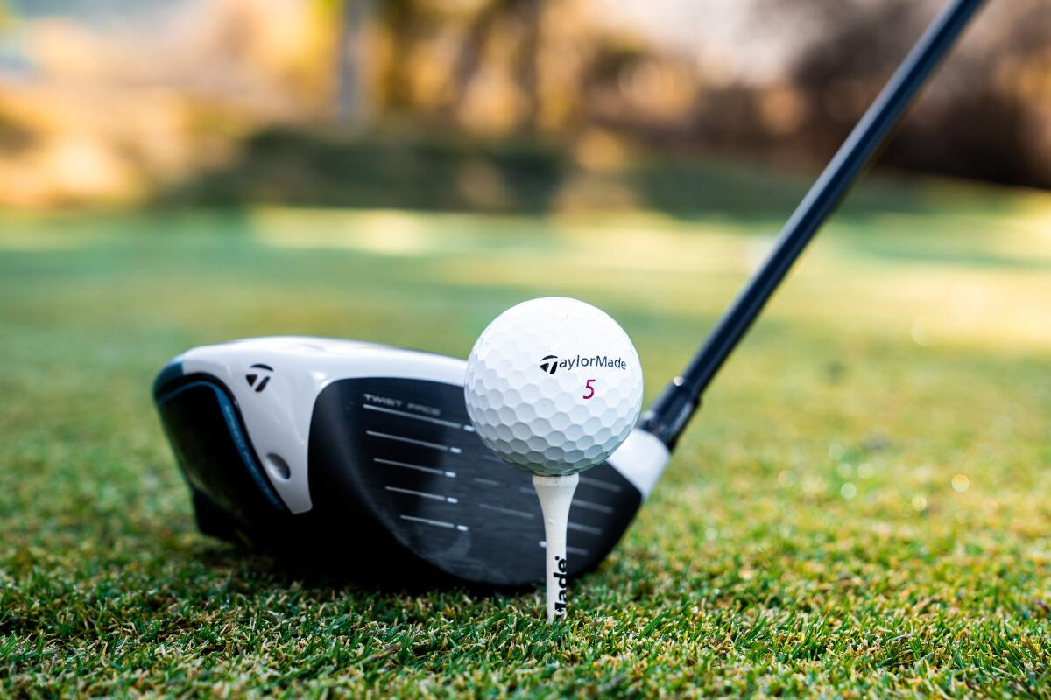
CEO COACHING
“ A TAILOR MADE COACHING PROGRAM ”

Slide 3
WHY

Slide 4

THE JOB OF A CEO IS VERY CHALLENGING!

Slide 5

THE PRESSURE TO PERFORM ON CEOs IS HIGHER THAN EVER

Slide 6

GLOBAL COMPETITION

Slide 7

THE FAST PACE OF CHANGING

Slide 8

CHANGING CUSTOMER DEMANDS

Slide 9

FLATTER ORGANIZATIONS

Slide 10

COMPETITION FOR GOOD TALENT

Slide 11

TECHNOLOGICAL
ADVANCEMENTS

Slide 12

GLOBALLY DIVERSE WORKFORCE

Slide 13

WHO
DOES A CEO ASK FOR HELP?

Slide 14

A COACH

Slide 15

A COACH
SOMEONE THAT SEES BEYOND YOUR LIMITS AND GUIDES YOU TO GREATNESS

Slide 16


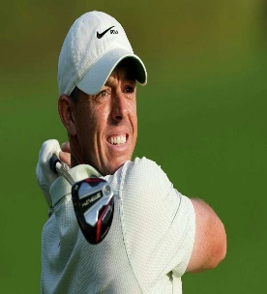
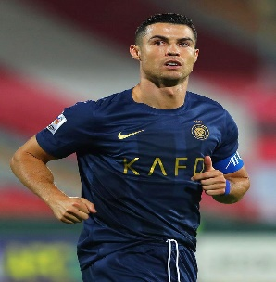

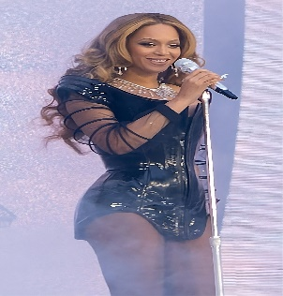
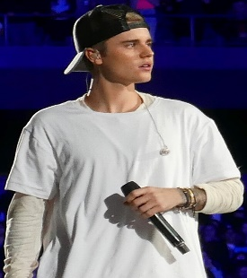
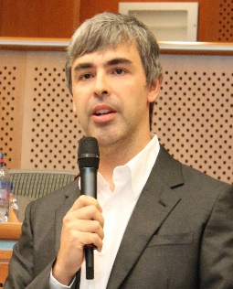
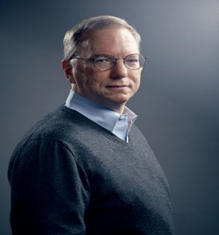
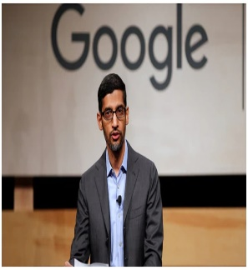
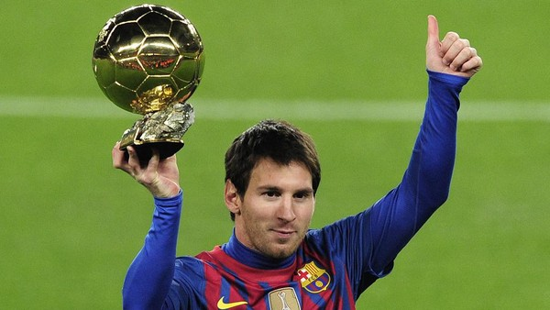
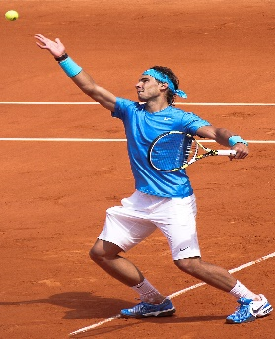
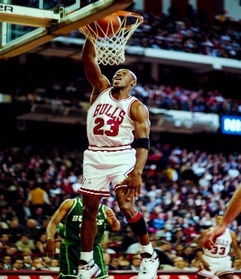



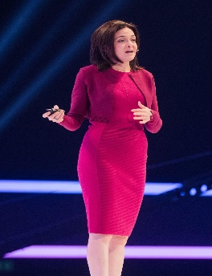
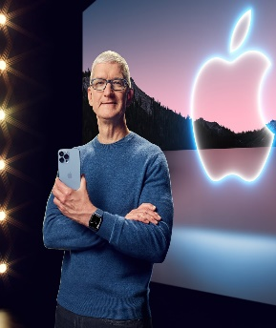
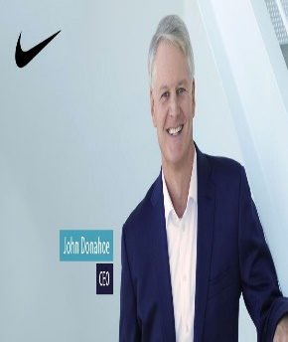
EVERY TOP PERFORMER HAS A COACH!
ATHLETES
ENTERTAINERS
LEADERS & BUSINESS OWNERS

Slide 17
COACHING
MENTORING
Roll up their sleeves and get their hands dirty
Get in the arena
Take responsibility
Dole out words of wisdom
Does not have full responsibility

Slide 18

63% of Asia Pacific CEOs believed their companies would no longer viable in ten years’ time if they continue on their current path.
27th Annual Global:
CEO Survey – Asia Pacific
PwC, January 2024

Slide 19

A majority of CEOs still don’t get the coaching they need.
Only 30% of CEO use a coach!
According to a study of over 200 CEOs by
Stanford University and Miles

Slide 20
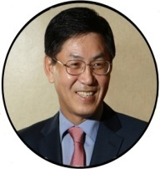
A WELCOME NOTE
CK Song, PhD
CCG Founder
CK Coaching Group (CCG) was founded to provide coaching and counseling that many leaders and organization need to tackle their business challenges and capture great opportunities.

Slide 21


VISION
MISSION
Our vision is to unlock the potential of every leaders that impact to overall people’s lives
Our mission is to grow by growing others (clients, colleagues, community) to build success and achieve their full potential

Slide 22
Purpose
EMBRACE OPPORTUNITIES
We help leaders and business owners tackling their most critical challenges, develop leadership skills, create new ideas and growth mindset into enduring business capabilities, and achieving best result for the future of their business

Slide 23
Our Values
We lead with Respect and Integrity

Slide 24
THE SERVICE
Redefining the way things are done
LEADERSHIP ADVISORY PROGRAM
GROUP COACHING
PREMIUM COACHING (Tailor Made Coaching Program)

Slide 25

THE COACH
Inspiring Executive Mastery for CEOs and C-Suite Clients
WHO
CK SONG, PhD

Slide 26
THE BENEFITS
Redefining the way things are done
COACHING PROGRAM BENEFITS
Achieve more growth and profitability
Build stronger relationships with stakeholders
(customer, employee, and management team)
Become a better and great leader

Slide 27
THE SERVICE
CEO COACHING PROGRAM
GROUP COACHING
1 YEAR PROGRAM
4 SESSIONS / YEAR (EVERY 3 MONTH)
EACH SESSION 1 DAY PROGRAM
MAX 20 PERSONS

Slide 28
THE SERVICE
CEO COACHING PROGRAM
PREMIUM COACHING
1 YEAR PROGRAM
8 SESSIONS / YEAR
EACH SESSION 1 DAY PROGRAM
MAX 4 PERSONS
1:1 TAILOR MADE COACHING PROGRAM

Slide 29
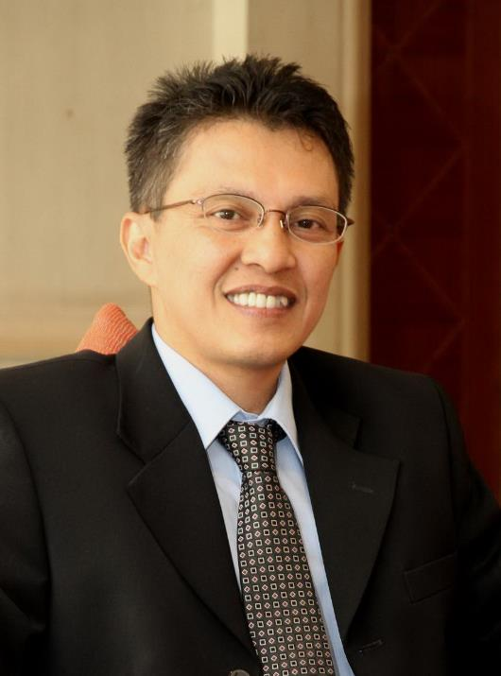
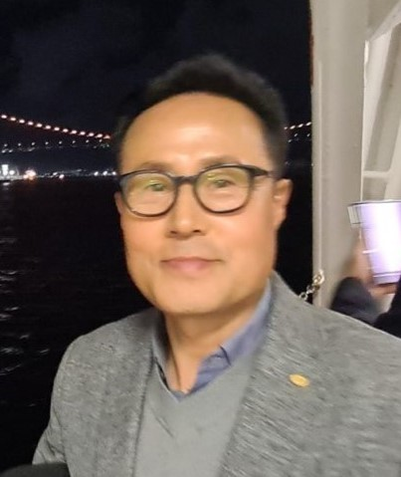
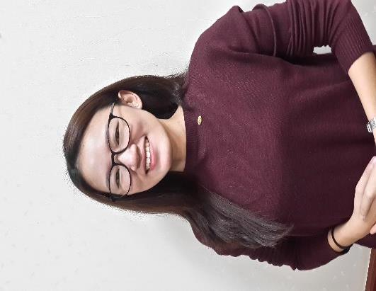
CCG MANAGEMENT TEAM
Erry Sunarli
JS OH
Sandi Benedicta
Creation Director
GM Indonesia
GM Korea

Slide 30



OFFICE LOCATION
WHERE
HEAD OFFICE
JAKARTA
BRANCH OFFICE
SEOUL

